Slide 1
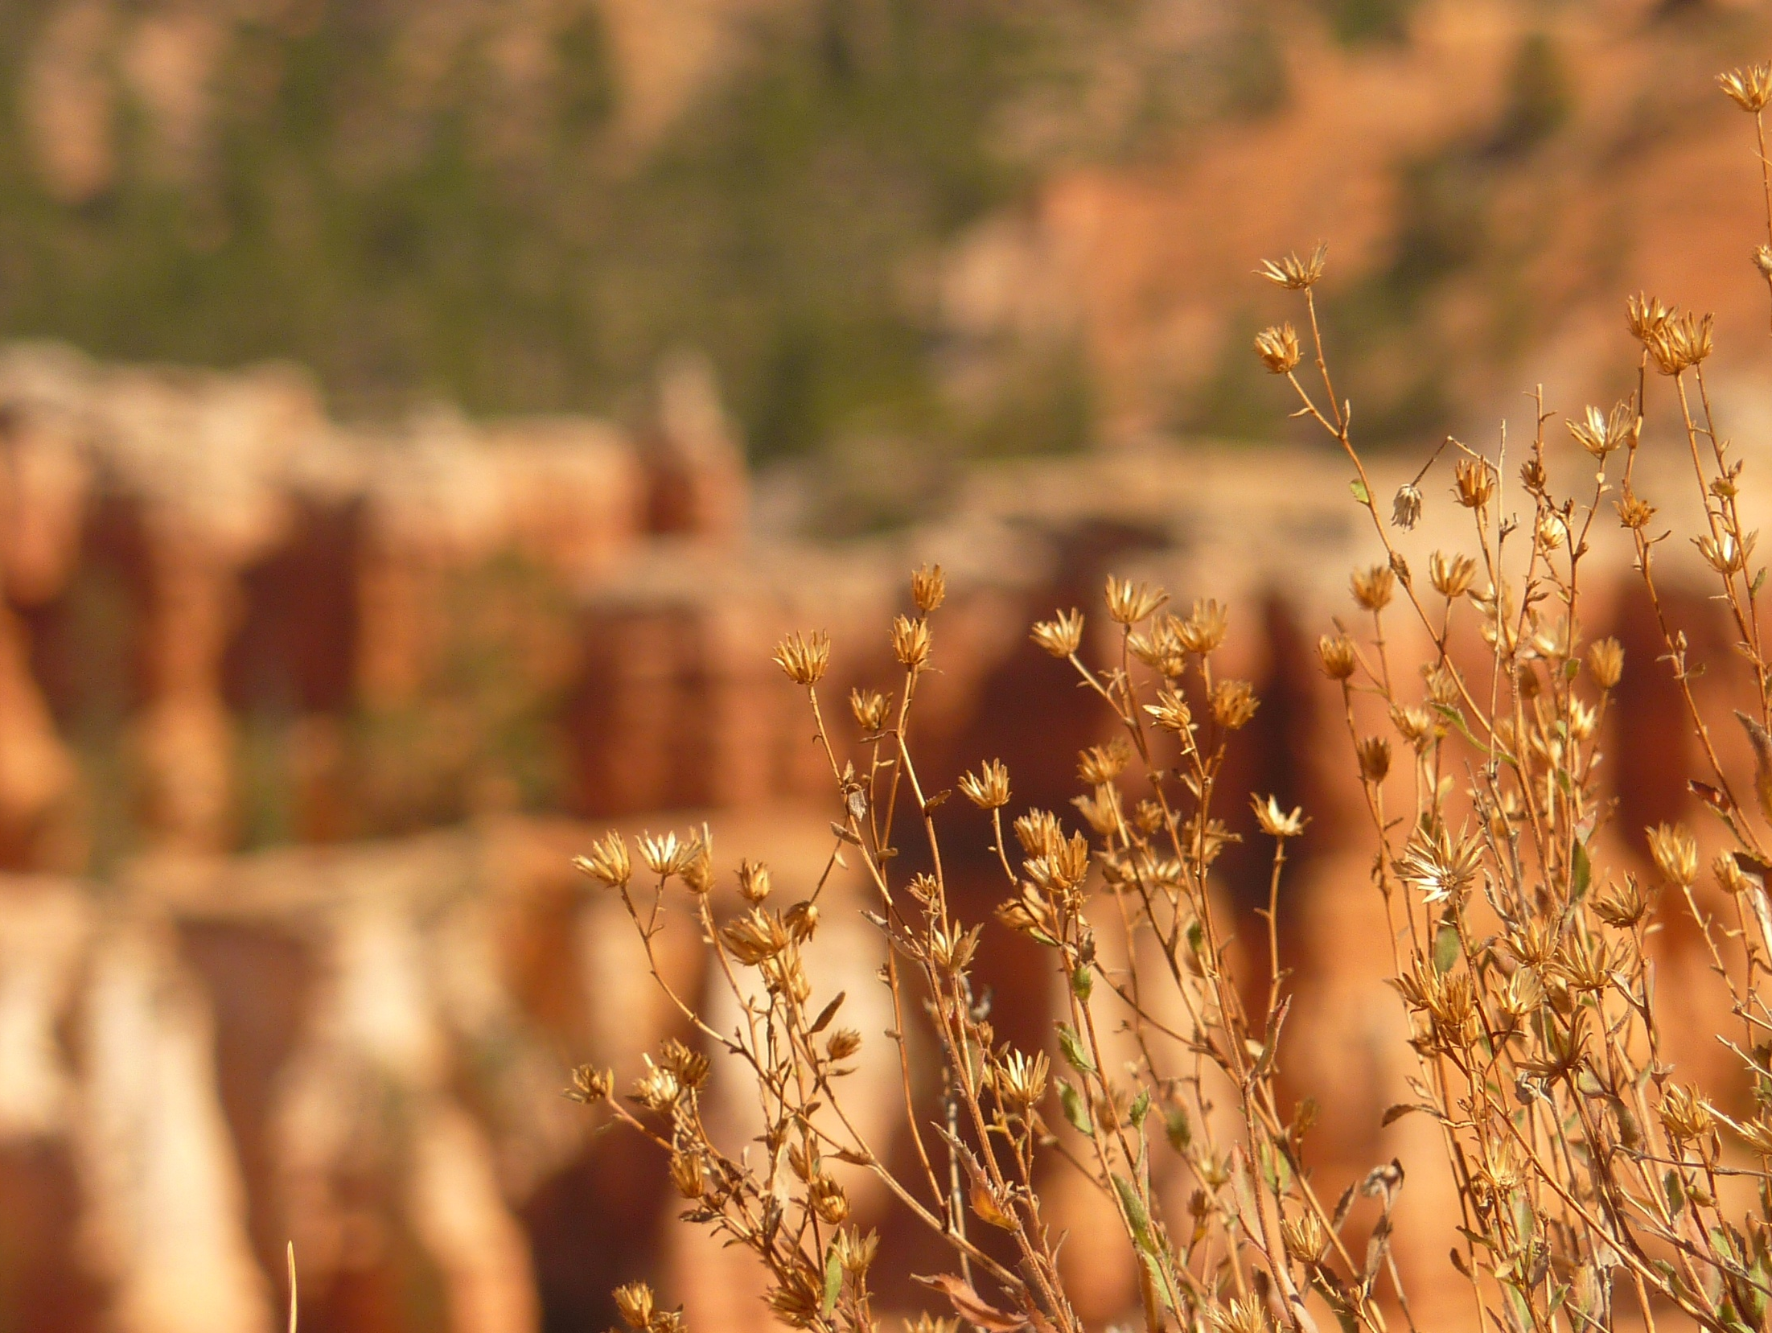
THANK THE
GOOD LORD
Notes:
1

Slide 2
THANK THE GOOD LORD
Thank the good Lord for all he’s done.
Thank the Good Lord for livin’
Thank the Good Lord for giving His love
and all my sins forgivin’.
He came to me to save my soul.
He came to set me free.
He’ll look after me for all my life
and all eternity.
Notes:
2

Slide 3
Thank the good Lord for all he’s done.
Thank the Good Lord for livin’
Thank the Good Lord for giving His love
and all my sins forgivin’.
He came to me to save my soul.
He came to set me free.
He’ll look after me for all my life
and all eternity.
Notes:
3

Slide 4
Thank the good Lord for all he’s done.
Thank the Good Lord for livin’
Thank the Good Lord for giving His love
and all my sins forgivin’.
He came to me to save my soul.
He came to set me free.
He’ll look after me for all my life
and all eternity.
Notes:
4

